Slide 1
PIP2001 Capstone Project
Review-1
Project Title:Relative Attractiveness Index of World Markets
Batch Number: 56
Roll Number | Student Name
20211CSE0375 | K Layasree
20211CSE0270 | Uppara dhanalakshmi
20211CSE0304 | R.Snehalatha Reddy
20211CSE0815 | Y.Siva Reddy
Under the Supervision of,
Ms.Kalpana K
School of Computer Science and Engineering
Presidency University
Name of the Program: B.tech (Computer Science Engineering)
Name of the HoD: Dr.Asif Mohammed
Name of the Program Project Coordinator: Mr.Amarnath J L ( AP)
Name of the School Project Coordinators: Dr. Sampath A K / Dr. Abdul Khadar A / Mr. Md Ziaur Rahman

Slide 2
Introduction
The Relative Attractiveness Index (RAI) serves as a pivotal tool for investors and stakeholders in the pharmaceutical industry, enabling them to assess the investment potential of various markets globally. As the pharmaceutical sector continues to evolve, characterized by rapid advancements in drug development, regulatory changes, and shifting market dynamics, the need for a robust analytical framework becomes increasingly critical. The RAI provides a comparative analysis of different markets based on key attributes such as profitability, risk, growth potential, and regulatory environment. By leveraging this index, investors can make informed decisions, identify lucrative opportunities, and navigate the complexities of the pharmaceutical landscape effectively.
This project aims to explore the application of the Relative Attractiveness Index in evaluating world markets within the pharmaceutical industry. It will delve into the methodologies employed in calculating the RAI, the challenges faced in the sector, and the implications of the findings for investment strategies.

Slide 3
Literature Review
Introduction:
The concept of the Relative Attractiveness Index (RAI) provides a framework for evaluating the attractiveness of investments across various markets, including the pharmaceutical sector.
The pharmaceutical industry presents unique challenges due to its reliance on R&D investments, regulatory hurdles, and long product lifecycles.
Key Research Findings:
US7882001: Graphical System for Determining Investment Attractiveness
ssrn_id3540484: Modeling Investment Attractiveness Using Entropy
Paper18: Comparative Analysis Pre/Post-COVID-19
Pharma Quality (1-s2.0-S1319016413001114)
Conclusion:
The literature on the Relative Attractiveness Index indicates its valuable role in evaluating pharmaceutical market investments by balancing quantitative and qualitative factors. However, methodologies like those using entropy analysis and fractal dynamics can benefit from incorporating more forward-looking factors like innovation potential and regulatory changes.
Notes:
Literature Review Slide Content:
Title: Literature Review
Introduction:
The concept of the Relative Attractiveness Index (RAI) provides a framework for evaluating the attractiveness of investments across various markets, including the pharmaceutical sector.
The pharmaceutical industry presents unique challenges due to its reliance on R&D investments, regulatory hurdles, and long product lifecycles.
Key Research Findings:
US7882001: Graphical System for Determining Investment Attractiveness
Strengths: Multi-factor evaluation using financial and growth indicators.
Application in Pharma: Aids in comparing peer companies based on risk and growth metrics.
Drawbacks: Complexity in interpretation and reliance on quantitative data alone.
ssrn_id3540484: Modeling Investment Attractiveness Using Entropy
Strengths: Predicts market instability using mathematical measures.
Application in Pharma: Evaluates risk and stability in volatile market conditions like the COVID-19 pandemic.
Drawbacks: Primarily uses historical data; qualitative factors like regulation and innovation potential are not integrated.
Paper18: Comparative Analysis Pre/Post-COVID-19
Strengths: Combines statistical and fractal methods to assess financial instruments, including those in pharma.
Drawbacks: Limited inclusion of qualitative factors like drug pipelines and patents.
Pharma Quality (1-s2.0-S1319016413001114)
Strengths: Reviews global pharma quality standards and highlights quality management practices like Six Sigma.
Application: Highlights quality as a competitive advantage in pharma, important for attracting investment.
Drawbacks: Few case studies on real-world implementation.
Conclusion:
The literature on the Relative Attractiveness Index indicates its valuable role in evaluating pharmaceutical market investments by balancing quantitative and qualitative factors. However, methodologies like those using entropy analysis and fractal dynamics can benefit from incorporating more forward-looking factors like innovation potential and regulatory changes.

Slide 4
Existing method Drawback
The existing methods for calculating the Relative Attractiveness Index (RAI) in the pharmaceutical industry have several drawbacks, as highlighted in the literature. Here are some key limitations:
Limited Focus on Emerging Trends
Generalization of Findings
Data Availability and Quality
Complexity of Market Dynamics
Subjectivity in Weighting Factors
Lack of Empirical Validation
Resource-Intensive Research
These drawbacks highlight the need for continuous improvement and adaptation of RAI methodologies to ensure they remain relevant and effective in guiding investment decisions in the pharmaceutical industry.
Notes:
The existing methods for calculating the Relative Attractiveness Index (RAI) in the pharmaceutical industry have several drawbacks, as highlighted in the literature. Here are some key limitations:
1. **Limited Focus on Emerging Trends**: Many existing methodologies primarily review established guidelines and practices, potentially overlooking newer trends and innovations in pharmaceutical quality management that could be relevant to the RAI [T2]. This can result in an incomplete assessment of market attractiveness.
2. **Generalization of Findings**: The findings derived from current RAI methodologies may not account for the specific contexts of different pharmaceutical companies or regions. This generalization can limit the applicability of the recommendations and insights provided by the RAI, making it less effective for targeted investment strategies [T2].
3. **Data Availability and Quality**: The effectiveness of the RAI is heavily dependent on the availability and quality of data used in its calculation. Inconsistent or incomplete data can lead to inaccurate assessments of market attractiveness, which may misguide investors [T4].
4. **Complexity of Market Dynamics**: The pharmaceutical industry is influenced by a multitude of factors, including regulatory changes, market volatility, and competitive pressures. Existing methods may struggle to adequately capture the complexity of these dynamics, leading to oversimplified evaluations [T1].
5. **Subjectivity in Weighting Factors**: The process of assigning weights to different factors in the RAI calculation can be subjective. Different stakeholders may prioritize various attributes differently, which can lead to inconsistencies in the RAI results and affect decision-making [T6].
6. **Lack of Empirical Validation**: There is a call for more empirical studies to validate the effectiveness of the methodologies used in calculating the RAI. Without robust validation, the reliability of the RAI as a decision-making tool remains uncertain [T2].
7. **Resource-Intensive Research**: The shift towards biologics and new chemical entities (NCEs) requires substantial investment and longer development timelines, which may pose financial risks for companies, especially smaller firms. Existing methods may not adequately address these financial implications in their assessments [T4].
These drawbacks highlight the need for continuous improvement and adaptation of RAI methodologies to ensure they remain relevant and effective in guiding investment decisions in the pharmaceutical industry.

Slide 5
Proposed Method
The proposed methods in the literature to overcome some of the drawbacks associated with existing Relative Attractiveness Index (RAI) methodologies include the following:
Incorporation of Emerging Trends
Context-Specific Analysis
Enhanced Data Quality and Availability
Inclusion of Qualitative Factors
Objective Weighting of Factors
Empirical Validation
Dynamic and Adaptive Models
By implementing these proposed methods, the RAI can be enhanced to provide a more comprehensive and accurate assessment of investment opportunities in the pharmaceutical sector, addressing many of the limitations identified in existing methodologies.
Notes:
The proposed methods in the literature to overcome some of the drawbacks associated with existing Relative Attractiveness Index (RAI) methodologies include the following:
1. **Incorporation of Emerging Trends**: The literature suggests that future RAI methodologies should integrate newer trends and innovations in pharmaceutical quality management. This would ensure that the RAI remains relevant and reflective of the current market dynamics, rather than relying solely on established practices [T2].
2. **Context-Specific Analysis**: To address the generalization of findings, the proposed methods emphasize the importance of conducting context-specific analyses. This involves tailoring the RAI calculations to account for the unique characteristics of different pharmaceutical companies or regional markets, thereby enhancing the applicability of the index [T2].
3. **Enhanced Data Quality and Availability**: The literature advocates for improved data collection methods and the use of high-quality, reliable data inputs. This would help mitigate the risks associated with poor data quality, leading to more accurate assessments of market attractiveness [T4].
4. **Inclusion of Qualitative Factors**: To capture the complexity of market dynamics, the proposed methods recommend incorporating qualitative factors into the RAI calculations. This could involve assessing brand reputation, customer loyalty, and other non-quantitative attributes that influence market attractiveness [T3].
5. **Objective Weighting of Factors**: The literature suggests developing a more systematic approach to weighting the various factors considered in the RAI. This could involve using statistical techniques or expert consensus to reduce subjectivity and bias in the weighting process [T6].
6. **Empirical Validation**: There is a strong emphasis on the need for empirical studies to validate the effectiveness of the proposed RAI methodologies. Conducting real-world case studies and analyses would help establish the reliability and robustness of the RAI as a decision-making tool [T2].
7. **Dynamic and Adaptive Models**: The proposed methods advocate for the development of dynamic RAI models that can adapt to rapid changes in external conditions, such as technological advancements or shifts in regulatory environments. This would allow the RAI to remain relevant in a fast-evolving industry [T3].
By implementing these proposed methods, the RAI can be enhanced to provide a more comprehensive and accurate assessment of investment opportunities in the pharmaceutical sector, addressing many of the limitations identified in existing methodologies.

Slide 6
Objectives
To Define the Relative Attractiveness Index: Establish a clear understanding of the RAI, its components, and its significance in the context of the pharmaceutical industry.
To Analyze Market Dynamics: Investigate the various factors influencing the attractiveness of pharmaceutical markets, including regulatory environments, market volatility, and growth forecasts.
To Evaluate Methodologies: Examine the methodologies used in calculating the RAI, including statistical and fractal analysis, and their applicability to the pharmaceutical sector.
To Identify Challenges and Opportunities: Highlight the challenges faced by the pharmaceutical industry, such as patent expirations, regulatory hurdles, and competition, while also identifying potential growth opportunities.
To Provide Strategic Insights: Offer actionable insights for investors and stakeholders on how to leverage the RAI for making informed investment decisions in the pharmaceutical markets.
To Foster Collaboration: Emphasize the importance of collaboration between industry and academia to enhance innovation and drive growth within the pharmaceutical sector.

Slide 7
Methodology/Modules
To make the project of developing a Relative Attractiveness Index (RAI) for the pharmaceutical industry possible, the following methodologies and modules are proposed:
Data Collection Module
Data Processing and Analysis Module
Model Development Module
Visualization Module
Validation and Testing Module
Deployment and Maintenance Module
By implementing these methodologies and modules, the project aims to create a robust and user-friendly RAI tool that can effectively guide investment decisions in the pharmaceutical industry.
Notes:
To make the project of developing a Relative Attractiveness Index (RAI) for the pharmaceutical industry possible, the following methodologies and modules are proposed:
1. **Data Collection Module**:
- **Market-Level Data**: Gather relevant data on various therapeutic areas, including market size, growth rates, R&D investments, and competitive intensity. This can involve using APIs (e.g., World Bank API) for real-time economic data and aggregating information from company reports and industry publications [T6].
- **Primary Research**: Conduct surveys or interviews to collect customer/patient preference data and insights on physician prescribing habits, which are crucial for understanding market dynamics [T1].
2. **Data Processing and Analysis Module**:
- **Statistical Analysis**: Use statistical tools and software (e.g., Python with Pandas or R) to analyze the collected data, identify trends, and calculate the RAI based on predefined criteria and weights [T5].
- **Normalization Techniques**: Implement normalization methods to ensure that data from different sources and scales can be compared effectively [T5].
3. **Model Development Module**:
- **RAI Calculation Model**: Develop a mathematical model to calculate the RAI by weighting various factors such as market size, growth potential, profitability, and regulatory environment. This model should allow for flexibility in adjusting weights based on stakeholder input [T4].
- **Dynamic Modeling**: Create a dynamic model that can adapt to changes in market conditions, allowing for real-time updates to the RAI as new data becomes available [T3].
4. **Visualization Module**:
- **User Interface Development**: Use frontend technologies (e.g., HTML/CSS, JavaScript, React.js or Vue.js) to create an interactive user interface that allows users to visualize the RAI results through charts, graphs, and maps [T5].
- **Data Visualization Tools**: Implement libraries like Chart.js or D3.js to render visual representations of the RAI and other relevant data, making it easier for users to interpret the results [T5].
5. **Validation and Testing Module**:
- **Empirical Validation**: Conduct case studies and real-world testing of the RAI model to validate its effectiveness and reliability. This may involve comparing the RAI results with actual market performance and investment outcomes [T2].
- **Feedback Mechanism**: Establish a feedback loop with stakeholders to refine the model based on user experiences and insights, ensuring continuous improvement [T2].
6. **Deployment and Maintenance Module**:
- **Web Application Deployment**: Deploy the web application on a suitable platform, ensuring it is accessible to users and can handle data requests efficiently [T5].
- **Ongoing Maintenance**: Plan for regular updates and maintenance of the application to incorporate new data, improve functionalities, and address any technical issues that arise [T6].
By implementing these methodologies and modules, the project aims to create a robust and user-friendly RAI tool that can effectively guide investment decisions in the pharmaceutical industry.

Slide 8
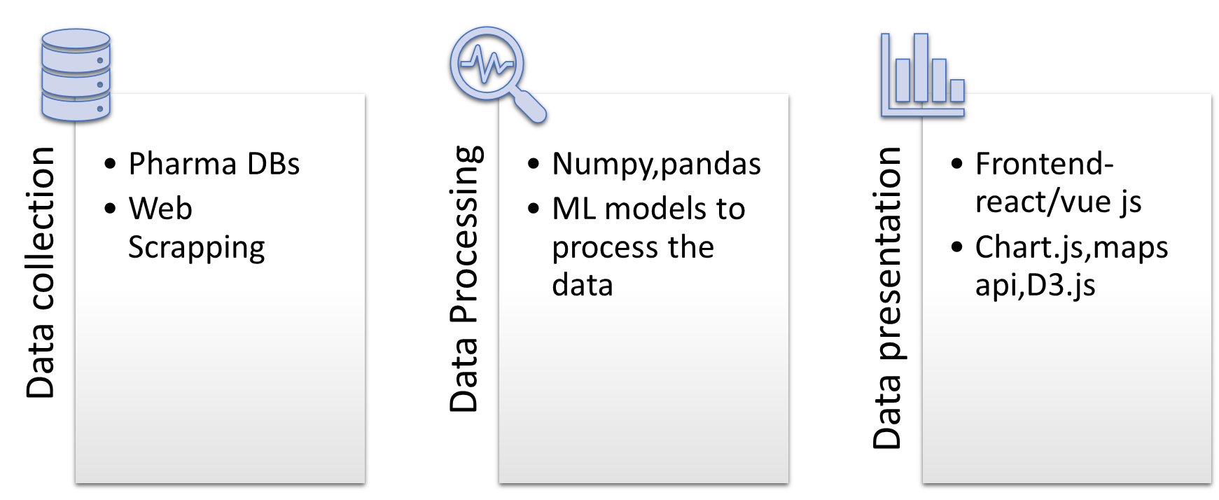
Architecture
Notes:
+---------------------+
| Data Collection |
| |
| +---------------+ |
| | World Bank | |
| | API | |
| +---------------+ |
| | |
| | |
| +---------------+ |
| | IMF API | |
| +---------------+ |
| | |
| | |
| +---------------+ |
| | Pharma DBs | |
| | (Evaluate, | |
| | IQVIA) | |
| +---------------+ |
| | |
| | |
| +---------------+ |
| | Web Scraping | |
| +---------------+ |
+---------|-----------+
|
v
+---------------------+
| Data Processing |
| |
| +---------------+ |
| | Python | |
| | (Pandas, | |
| | NumPy) | |
| +---------------+ |
| | |
| | |
| +---------------+ |
| | ML Models | |
| +---------------+ |
+---------|-----------+
|
v
+---------------------+
| Data Presentation |
| |
| +---------------+ |
| | Frontend UI | |
| | (React.js / | |
| | Vue.js) | |
| +---------------+ |
| | |
| | |
| +---------------+ |
| | Visualization | |
| | (Chart.js, | |
| | D3.js, | |
| | Maps API) | |
| +---------------+ |
+---------------------+

Slide 9
Hardware/software components
To successfully execute the project of developing a Relative Attractiveness Index (RAI) for the pharmaceutical industry, the following components are required:
Data Sources : APIs, Market Research Reports, Company Financials
Data Collection Tools : Web Scraping Tools, Survey Tools
Data Processing and Analysis Software:Programming Languages, Data Analysis Libraries
Database Management : Relational Database , NoSQL Database (Optional)
Frontend Development Tools : HTML/CSS, JavaScript Frameworks
Backend Development Tools : Node.js with Express ,Python (Optional)
Data Visualization Tools : Charting Libraries(Chart.js or D3.js ) ,Mapping Libraries
Testing and Validation Tools : Statistical Software ,User Feedback Mechanisms
Deployment and Hosting : Web Hosting Services ,Version Control Systems
Project Management Tools : Collaboration Platforms, Documentation Tools
By assembling these components, the project can be effectively developed, deployed, and maintained, ensuring a comprehensive and user-friendly RAI tool for the pharmaceutical industry.
Notes:
To successfully execute the project of developing a Relative Attractiveness Index (RAI) for the pharmaceutical industry, the following components are required:
1. **Data Sources**:
- **APIs**: Access to reliable APIs such as the World Bank API, International Monetary Fund (IMF) API, and other economic data sources for real-time data collection [T2].
- **Market Research Reports**: Subscription to industry reports from firms like IQVIA or EvaluatePharma for detailed market insights [T3].
- **Company Financials**: Access to financial statements and reports from pharmaceutical companies to gather data on R&D investments and market performance [T4].
2. **Data Collection Tools**:
- **Web Scraping Tools**: Use of Python libraries like BeautifulSoup or Scrapy for gathering data from online sources when APIs are not available [T2].
- **Survey Tools**: Platforms for conducting surveys or interviews to collect primary data on customer preferences and physician habits [T4].
3. **Data Processing and Analysis Software**:
- **Programming Languages**: Proficiency in Python or R for data analysis, statistical modeling, and calculations of the RAI [T5].
- **Data Analysis Libraries**: Use of libraries such as Pandas and NumPy in Python for data manipulation and analysis [T5].
4. **Database Management**:
- **Relational Database**: MySQL or PostgreSQL for storing structured data related to countries, economic factors, and historical RAI data [T6].
- **NoSQL Database (Optional)**: MongoDB for handling complex data structures, especially if detailed country profiles are involved [T6].
5. **Frontend Development Tools**:
- **HTML/CSS**: For structuring and styling the web application [T6].
- **JavaScript Frameworks**: React.js or Vue.js for building an interactive user interface that allows users to visualize and interact with the RAI data [T5].
6. **Backend Development Tools**:
- **Node.js with Express**: For creating APIs that serve data to the frontend and handle data processing requests [T6].
- **Python (Optional)**: For handling data-intensive tasks and complex calculations, especially if using data analysis libraries [T6].
7. **Data Visualization Tools**:
- **Charting Libraries**: Chart.js or D3.js for rendering visual representations of the RAI and other relevant data [T5].
- **Mapping Libraries**: Leaflet.js or Google Maps API for displaying geographic data and comparisons visually [T6].
8. **Testing and Validation Tools**:
- **Statistical Software**: Tools for conducting empirical validation and testing the RAI model against real-world data [T2].
- **User Feedback Mechanisms**: Systems for collecting user feedback to refine and improve the RAI model and application [T2].
9. **Deployment and Hosting**:
- **Web Hosting Services**: A reliable hosting platform to deploy the web application, ensuring it is accessible to users [T5].
- **Version Control Systems**: Tools like Git for managing code changes and collaboration among team members [T6].
10. **Project Management Tools**:
- **Collaboration Platforms**: Tools like Trello, Asana, or Jira for project management and tracking progress [T6].
- **Documentation Tools**: Platforms for maintaining project documentation, such as Confluence or Google Docs [T6].
By assembling these components, the project can be effectively developed, deployed, and maintained, ensuring a comprehensive and user-friendly RAI tool for the pharmaceutical industry.

Slide 10
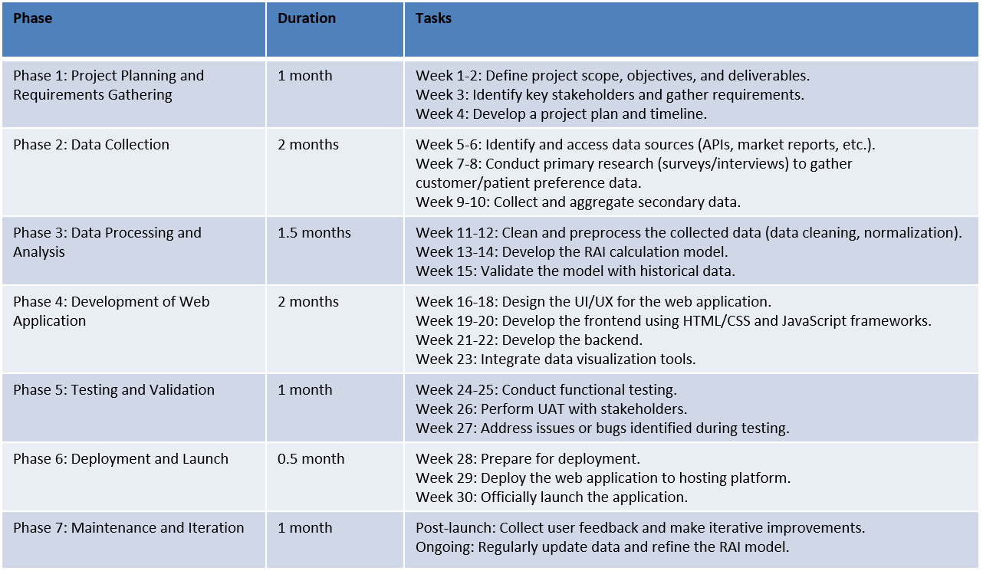
Timeline of Project
The expected timeline for the project of developing a Relative Attractiveness Index (RAI) for the pharmaceutical industry can be broken down into several phases, each with specific tasks and estimated durations. Below is a suggested timeline, assuming a project duration of approximately 6 to 9 months:
Notes:
The expected timeline for the project of developing a Relative Attractiveness Index (RAI) for the pharmaceutical industry can be broken down into several phases, each with specific tasks and estimated durations. Below is a suggested timeline, assuming a project duration of approximately 6 to 9 months:
### Phase 1: Project Planning and Requirements Gathering (1 month)
- **Week 1-2**: Define project scope, objectives, and deliverables.
- **Week 3**: Identify key stakeholders and gather requirements.
- **Week 4**: Develop a project plan and timeline.
### Phase 2: Data Collection (2 months)
- **Week 5-6**: Identify and access data sources (APIs, market reports, etc.).
- **Week 7-8**: Conduct primary research (surveys/interviews) to gather customer/patient preference data.
- **Week 9-10**: Collect and aggregate secondary data from various sources (financial reports, market research).
### Phase 3: Data Processing and Analysis (1.5 months)
- **Week 11-12**: Clean and preprocess the collected data (data cleaning, normalization).
- **Week 13-14**: Develop the RAI calculation model and perform initial analyses.
- **Week 15**: Validate the model with historical data and refine as necessary.
### Phase 4: Development of Web Application (2 months)
- **Week 16-18**: Design the user interface and user experience (UI/UX) for the web application.
- **Week 19-20**: Develop the frontend using HTML/CSS and JavaScript frameworks (React.js or Vue.js).
- **Week 21-22**: Develop the backend using Node.js and set up the database (MySQL/PostgreSQL).
- **Week 23**: Integrate data visualization tools (Chart.js, D3.js) and mapping libraries.
### Phase 5: Testing and Validation (1 month)
- **Week 24-25**: Conduct functional testing of the web application (frontend and backend).
- **Week 26**: Perform user acceptance testing (UAT) with stakeholders to gather feedback.
- **Week 27**: Address any issues or bugs identified during testing.
### Phase 6: Deployment and Launch (0.5 month)
- **Week 28**: Prepare for deployment (finalize documentation, user guides).
- **Week 29**: Deploy the web application to a hosting platform.
- **Week 30**: Officially launch the application and monitor for any post-launch issues.
### Phase 7: Maintenance and Iteration (Ongoing)
- **Post-Launch**: Collect user feedback and make iterative improvements to the application.
- **Ongoing**: Regularly update the data and refine the RAI model based on new insights and market changes.
### Summary Timeline
- **Total Duration**: Approximately 6 to 9 months, depending on the complexity of the project and the availability of resources.
This timeline is a general guideline and may need to be adjusted based on specific project requirements, team capacity, and unforeseen challenges that may arise during the development process. Regular check-ins and updates to the timeline will help keep the project on track.

Slide 11
Expected Outcomes
A simple user interface to make consumers understand the rai and customization of factors
Notes:
A simple user interface to make consumers understand the rai and customization of factors

Slide 12
Conclusion
1. Comprehensive Analysis Tool
- The Relative Attractiveness Index (RAI) provides a systematic, data-driven approach for evaluating global markets in the pharmaceutical industry.
- By integrating both quantitative factors (economic data, market size, growth rates) and qualitative factors (regulatory environment, innovation potential), the RAI offers a holistic view of market attractiveness.
2. AI-Driven Insights
- The use of AI and machine learning tools(Python, statistical models) in processing large datasets ensures accuracy and scalability in analyzing multiple countries and companies.
- This enables real-time decision-making, helping investors, businesses, and policymakers make informed decisions.
3. Interactive Visualization
- The platform provides a user-friendly interface with interactive charts and maps, making it easy to compare and visualize market and company-level data across different regions.
- Tools like Chart.js and Leaflet.js enhance data presentation, offering valuable insights for business expansion and investment strategies.
4. Future Prospects
- As global pharmaceutical markets evolve, the RAI can continuously adapt by incorporating emerging trends such as biotechnology advancements, regulatory shifts, and market dynamics, keeping stakeholders informed with up-to-date insights.
Notes:
### **Conclusion Slide Content:**
---
**Title: Conclusion**
1. **Comprehensive Analysis Tool**
- The **Relative Attractiveness Index (RAI)** provides a systematic, data-driven approach for evaluating global markets in the pharmaceutical industry.
- By integrating both **quantitative factors** (economic data, market size, growth rates) and **qualitative factors** (regulatory environment, innovation potential), the RAI offers a holistic view of market attractiveness.
2. **AI-Driven Insights**
- The use of **AI and machine learning tools** (Python, statistical models) in processing large datasets ensures accuracy and scalability in analyzing multiple countries and companies.
- This enables real-time decision-making, helping investors, businesses, and policymakers make informed decisions.
3. **Interactive Visualization**
- The platform provides a user-friendly interface with **interactive charts and maps**, making it easy to compare and visualize market and company-level data across different regions.
- Tools like **Chart.js** and **Leaflet.js** enhance data presentation, offering valuable insights for business expansion and investment strategies.
4. **Future Prospects**
- As global pharmaceutical markets evolve, the RAI can continuously adapt by incorporating **emerging trends** such as **biotechnology advancements**, regulatory shifts, and market dynamics, keeping stakeholders informed with up-to-date insights.
---
**Takeaway**:
The RAI project stands as a robust tool for evaluating the **pharmaceutical industry's global attractiveness**, combining **AI-driven data analysis** with interactive visualization to support better decision-making in a complex market environment.

Slide 13
Github Link
The Github link provided should have public access permission.
Github Link

Slide 14
References
Notes:
Its there in the word file i sent u bruh

Slide 15
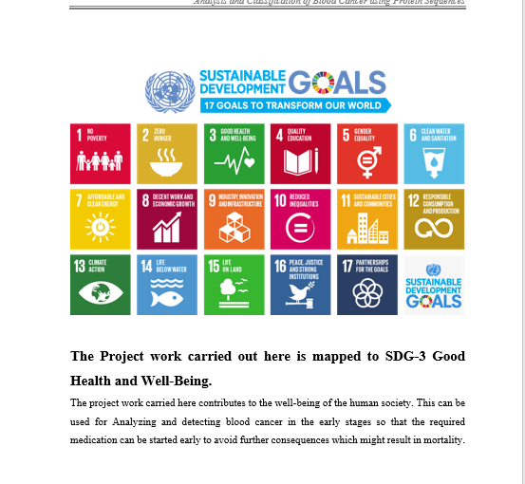
Project work mapping with SDG
Notes:
8th one,9thone

Slide 16
Thank You

